Slide 1
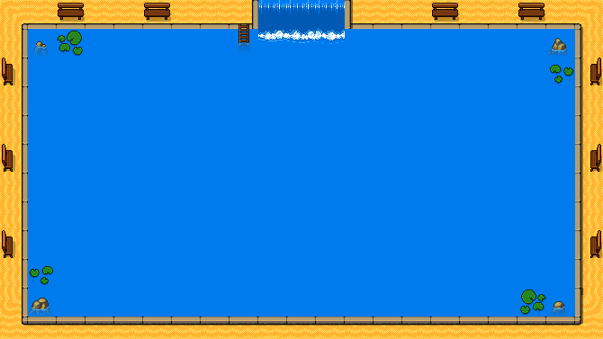



THE VIRTUE OF A SOLDIER
IS IN THE SHINE OF ITS HEARTH

Slide 2
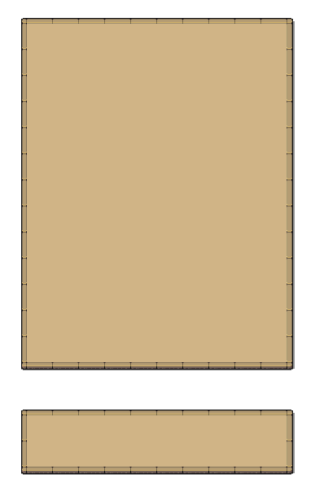


Gabriel Vergari
Nuno Teixeira

Slide 3
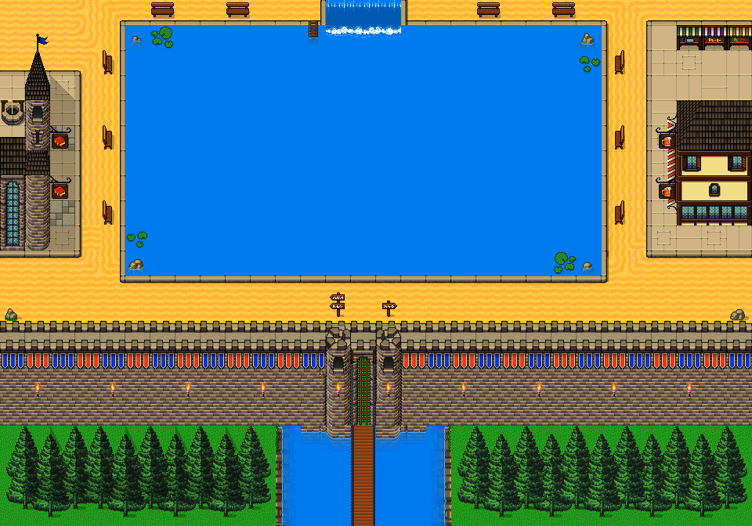
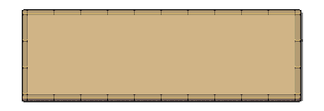
Overview
Normanda is a 2d single-player dangeon crawler game for Windows.

Slide 4
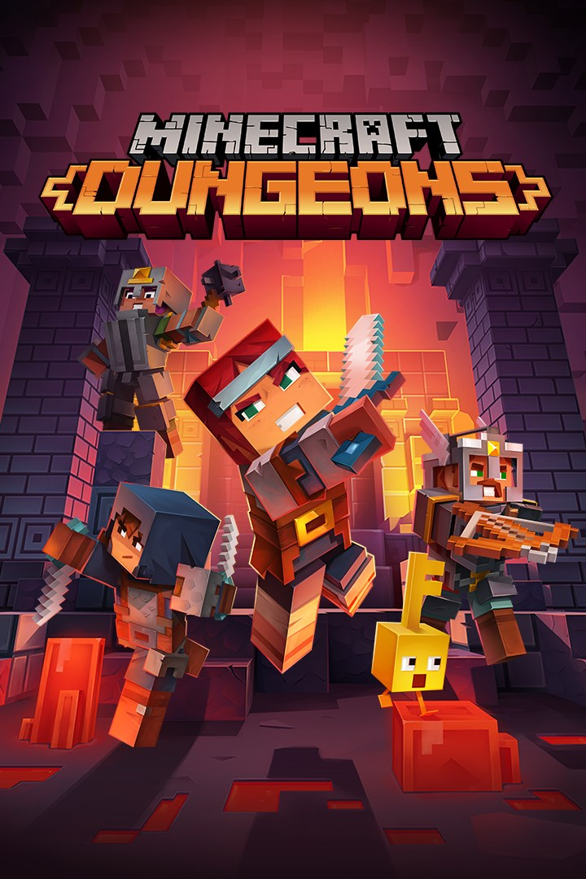
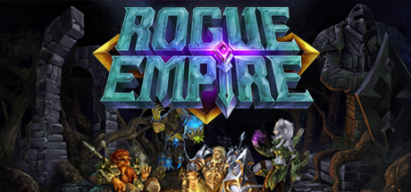

Inspiration

Slide 5
Setting
Normanda take place in a medieval city that is in iminente danger.
Monster appear in the other side of a portal and you must stop them.
The player is known as “Adventuror”.

Slide 6
GAMEPLAY

Slide 7
Movement & Combat
Adventuror can move in the X and Y axis
Combat:
Basic Attack
Strong attacK
Block

Slide 8
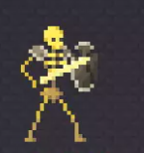
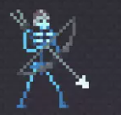
Enemies & behavior
2 types of enemies that protect the dungeon.
Different behavior and formulas.

Slide 9
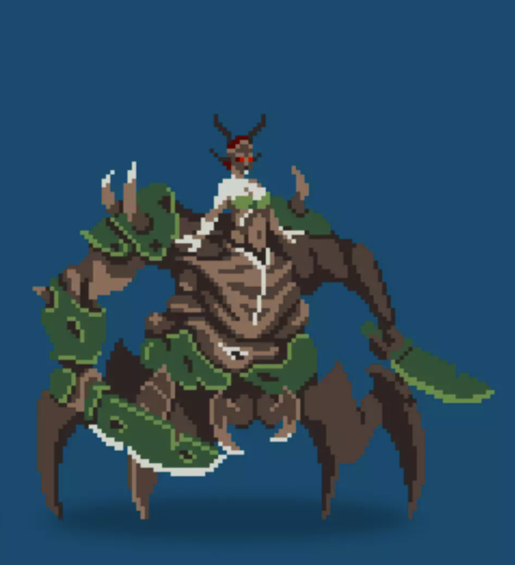
Final boss
The relation with both worlds
Mutan of Human and monster
The god of the other world
Own Behavior

Slide 10
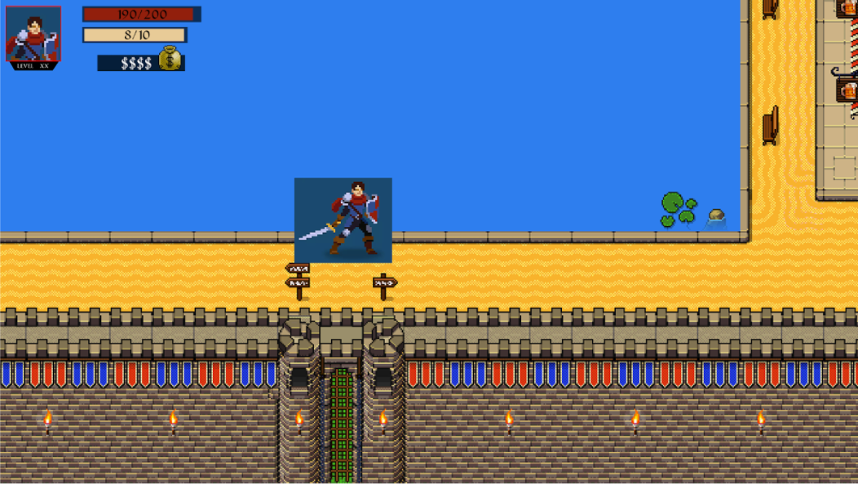
REward
Killing enemies give you gold and Experience.
Chests in the dungeons.

Slide 11
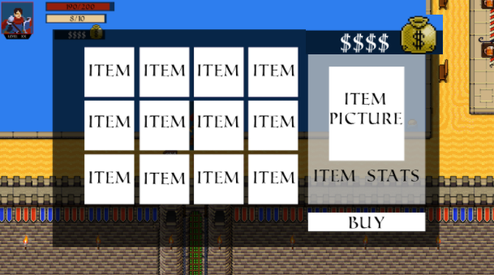
Stores
The player can spend his gold with new items
Swords
Shields
potions

Slide 12
Companion app

Slide 13
Elevator pitch
For adventurers that need simple Lore and mechanics, our companion app offers challenges that fit into anyone's time, guaranteeing the feeling of challenge and fun.
Our Companion app is more relevant than others because you can set the challenge time to kill enemies and complete as you will.

Slide 14
Integration
- Output of the stats of the player in the companion app.
- The player can imput an amount of time to set a challenge, this challenge if completed output an extra amount of experience.

Slide 15
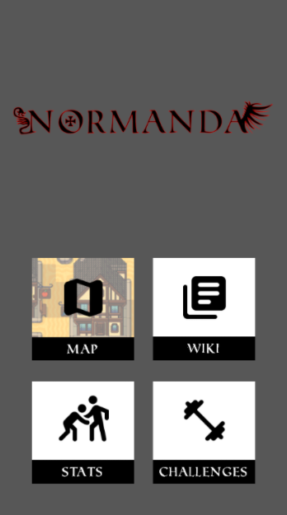
menus
Map
Wiki
Stats
challenges

Slide 16
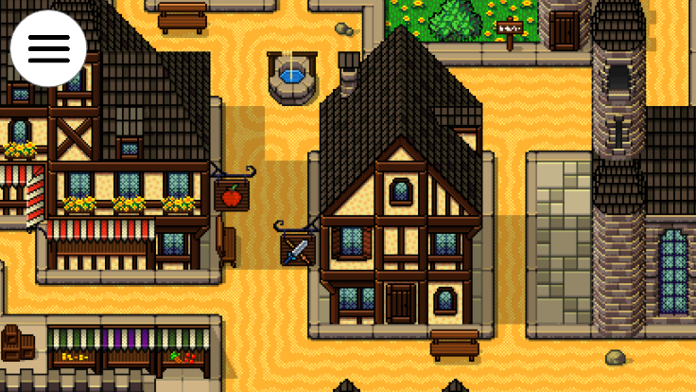
MAP
- Secrets of the map and a guide through.

Slide 17
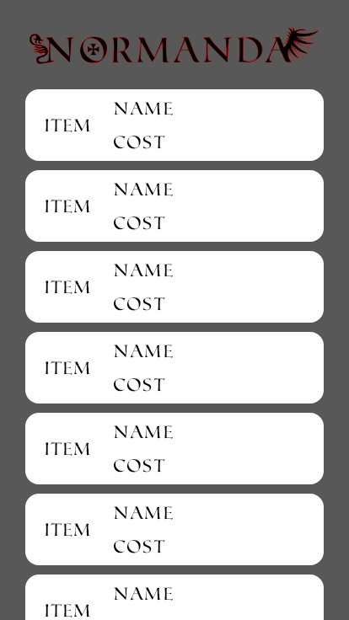
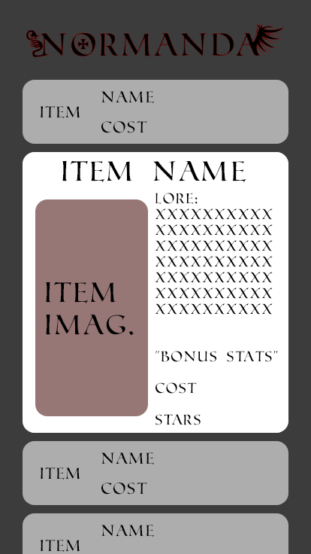
Wiki
Exhibition of items.
The current information of the items

Slide 18
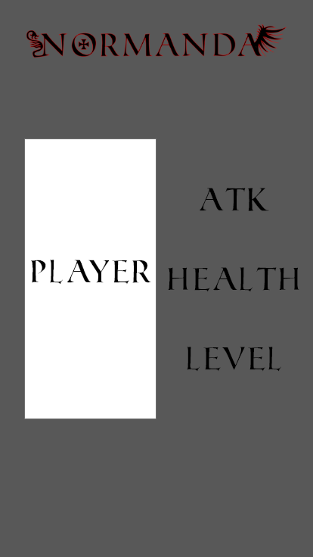
Stats
Exhibition of the player.
The current information is added to the previously mentioned items.

Slide 19
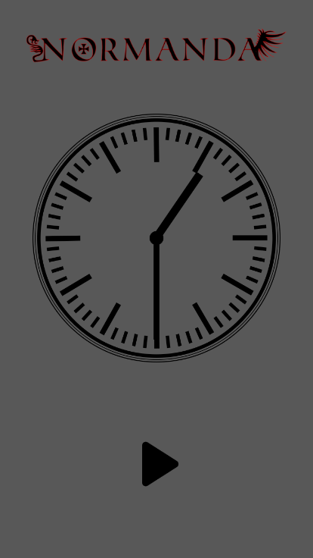
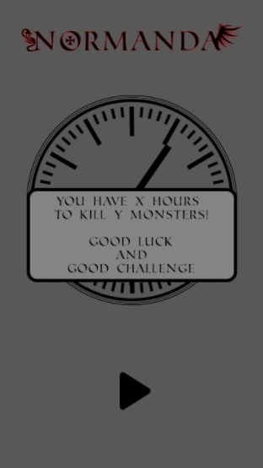
Challenges
The player set an amount of time.
He must complete the challenge to gain extra exp.

Slide 20
If(QUESTIONS == TRUE){
Answer();
} Else {
Debug.log(“Thank you”);
}

